Slide 1
Python
Unit 1

Slide 2
1. Conceptual Introduction to Python
What is Python?
Python is a high-level, interpreted, and object-oriented programming language created by Guido van Rossum. It is simple, easy to learn, and widely used for:
Web Development
Data Science
Artificial Intelligence
Machine Learning
Automation
Game Development
Desktop Applications
IoT Applications

Slide 3
1. Conceptual Introduction to Python
Features of Python
Easy and simple syntax
Open-source language
Platform independent
Interpreted language
Supports Object-Oriented Programming
Large standard library
Dynamically typed language

Slide 4
1. Conceptual Introduction to Python
Applications of Python
Web Applications
Data Analysis
Cyber Security
Software Development
Automation Scripts
Cloud Computing

Slide 5
2. Installation and Working with Python
Installing Python
Step 1: Download Python
Visit the official website:
Python Official Website
Step 2: Install Python
Download the latest version
Run the installer
Select “Add Python to PATH”
Click Install Now

Slide 6
2. Installation and Working with Python
Installing Visual Studio Code
Download VS Code
Visual Studio Code Official Website
Steps
Download VS Code
Install the software
Open VS Code
Install Python Extension

Slide 7
2. Installation and Working with Python
Installing Python Extension in VS Code
Open VS Code
Go to Extensions
Search for “Python”
Install extension by Microsoft

Slide 8
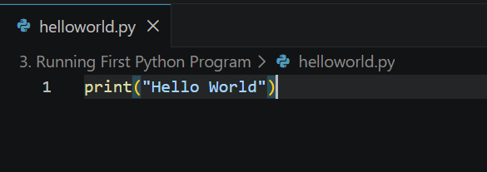
3. Running First Python Program
Example Program
print("Hello World")
Output
Hello World
Steps to Run Program
Open VS Code
Create a new file with .py extension
Write Python code
Save the file
Click Run button

Slide 9
4. Understanding Python Variables
What is a Variable?
A variable is a container used to store data values.
Rules for Variable Names
Variable name can contain letters, digits, and underscore
Cannot start with a digit
Cannot use special symbols
Keywords are not allowed

Slide 10
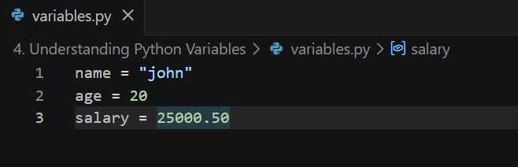
4. Understanding Python Variables
Example
name = "john"
age = 20
salary = 25000.50

Slide 11
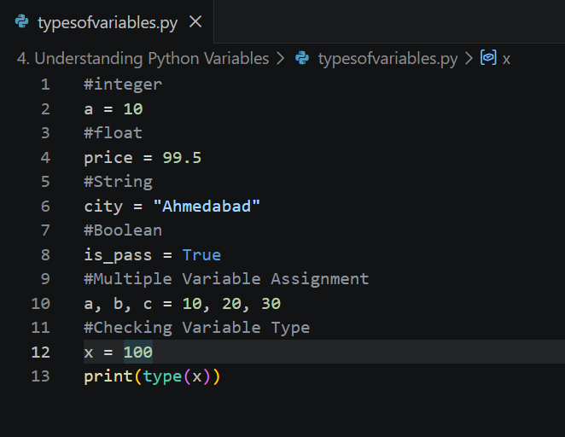
4. Understanding Python Variables
Types of Variables

Slide 12
5. Python Basic Operators
Operators are symbols used to perform operations on variables and values.
Types of Operators

Slide 13
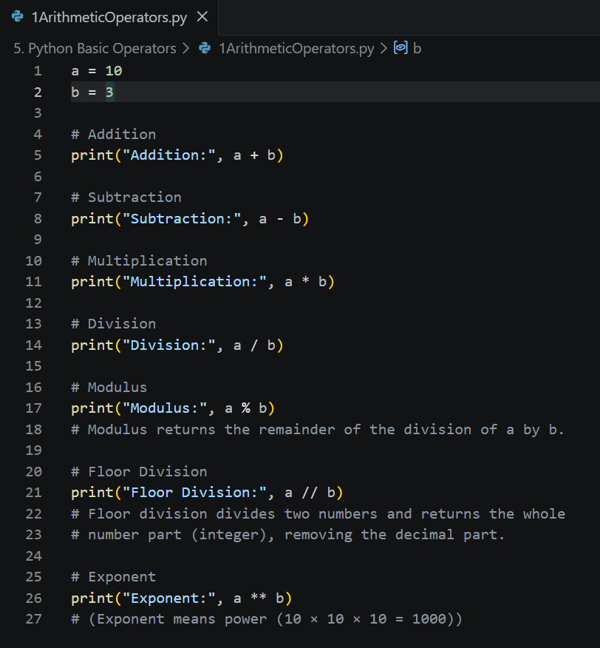
5. Python Basic Operators
1. Arithmetic Operators
Operator | Description | Example
+ | Addition | a + b
- | Subtraction | a - b
* | Multiplication | a * b
/ | Division | a / b
% | Modulus | a % b
// | Floor Division | a // b
** | Exponent | a ** b

Slide 14
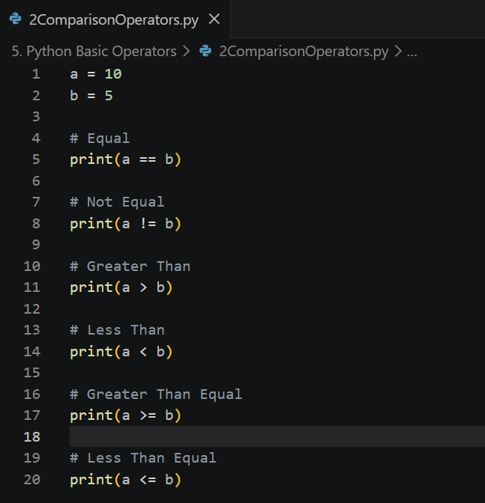
5. Python Basic Operators
2. Comparison Operators
Operator | Description
== | Equal
!= | Not Equal
> | Greater Than
< | Less Than
>= | Greater Than Equal
<= | Less Than Equal

Slide 15
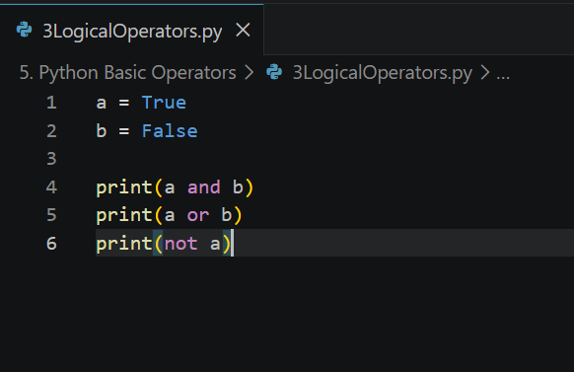
5. Python Basic Operators
3. Logical Operators
Operator | Description
and | Returns True if both conditions are true
or | Returns True if one condition is true
not | Reverse the condition

Slide 16
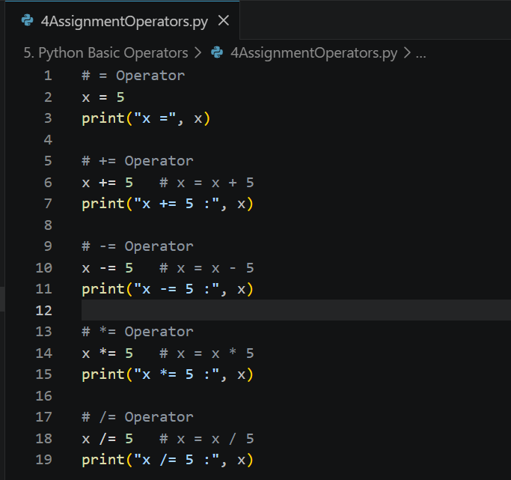
5. Python Basic Operators
4. Assignment Operators
Operator | Example
= | x = 5
+= | x += 5
-= | x -= 5
*= | x *= 5
/= | x /= 5

Slide 17
6. Understanding Python Blocks
What are Python Blocks?
A block is a group of statements having the same indentation level.
Python uses indentation instead of braces {}.

Slide 18
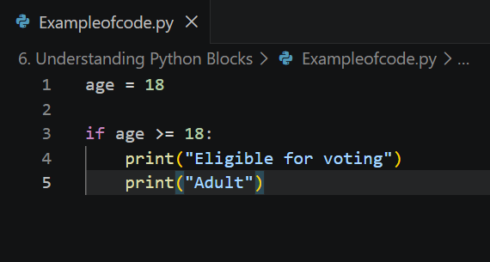
6. Understanding Python Blocks
Example of Block
age = 18 if age >= 18: print("Eligible for voting") print("Adult")
Important Points
Indentation is mandatory in Python
Usually 4 spaces are used
Incorrect indentation gives error

Slide 19
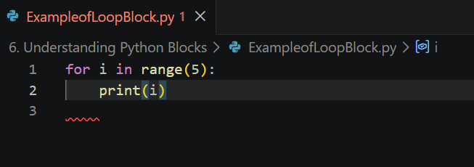
6. Understanding Python Blocks
Example of Loop Block
for i in range(5): print(i)
Formula of range()
range(start, stop)
start → included
stop → not included

Slide 20
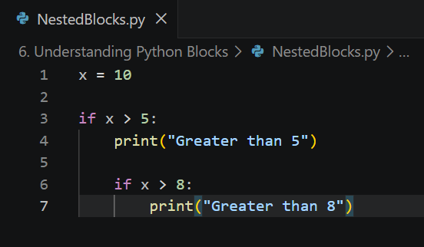
6. Understanding Python Blocks
Nested Blocks
x = 10 if x > 5: print("Greater than 5") if x > 8: print("Greater than 8")

